Slide 1
Customer Segmentation & Churn Prediction
Name : Swapnil Johri

Slide 2
Background
India's online grocery business, estimated to be worth $2.9 billion in 2020, is expected to increase at a CAGR of 37.1% from 2021 to 2028.
The market has experienced tremendous growth over the past few months due to changing consumer lifestyles, increasing urbanisation, and the tech-savvy youth favouring online shopping.
Due to increasing disposable income and busy lifestyles, people increasingly use customised and practical online platforms for food shopping rather than visiting their local vendors.
Consumers are shifting their attention to online grocery shopping due to various factors because it is not only handy but also a safe option. For this reason, offline retail shops/companies are trying to move to the online business space to cope with the fast-growing market.
Retailkart.com is a small and medium-scale organization that deals in wine, fruit and meat products, holding around 35% offline market share. The company has been leading the domain offline for a long time. Due to increased competition, they decided to move online as well.
Through competitive research, the company has found that the cost of acquiring a new customer is as high as ₹500 for retailkart.com.
The major challenge is that a churned-out customer is as good as a new customer. Customer acquisition always comes with a cost. Building and maintaining trust by providing seamless experience consistently is one of the biggest challenges for any company.
Accurately segregating segments and identifying customers with a high probability of churn would be the first step towards solving the problem.

Slide 3
Implementation

Slide 4
Implementation Measures
Data Gathering : Loading & Observing the past data provided
Data Cleaning : Duplicate removal, null value treatment, unnecessary column elimination, etc.
Performing EDA : Focus on different factors, & understand underlying pattern/trend through visualizations
Insights : Derive insights through created visualizations

Slide 5
Analysis & Insights

Slide 6
Customer Segmentation

Slide 7
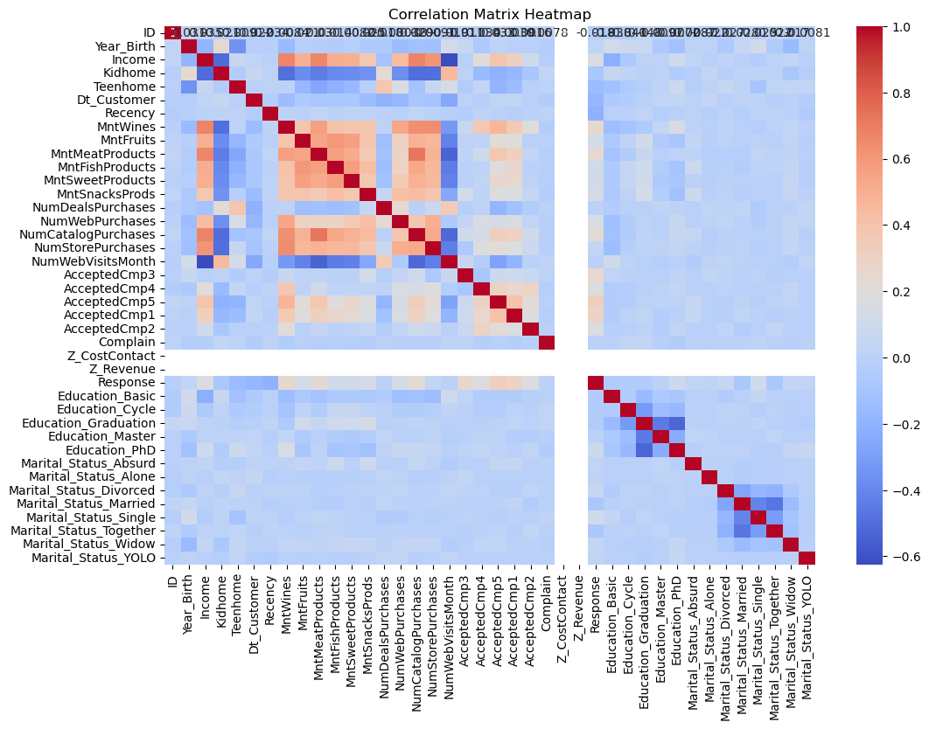
1. Correlation Matrix Heatmap

Slide 8
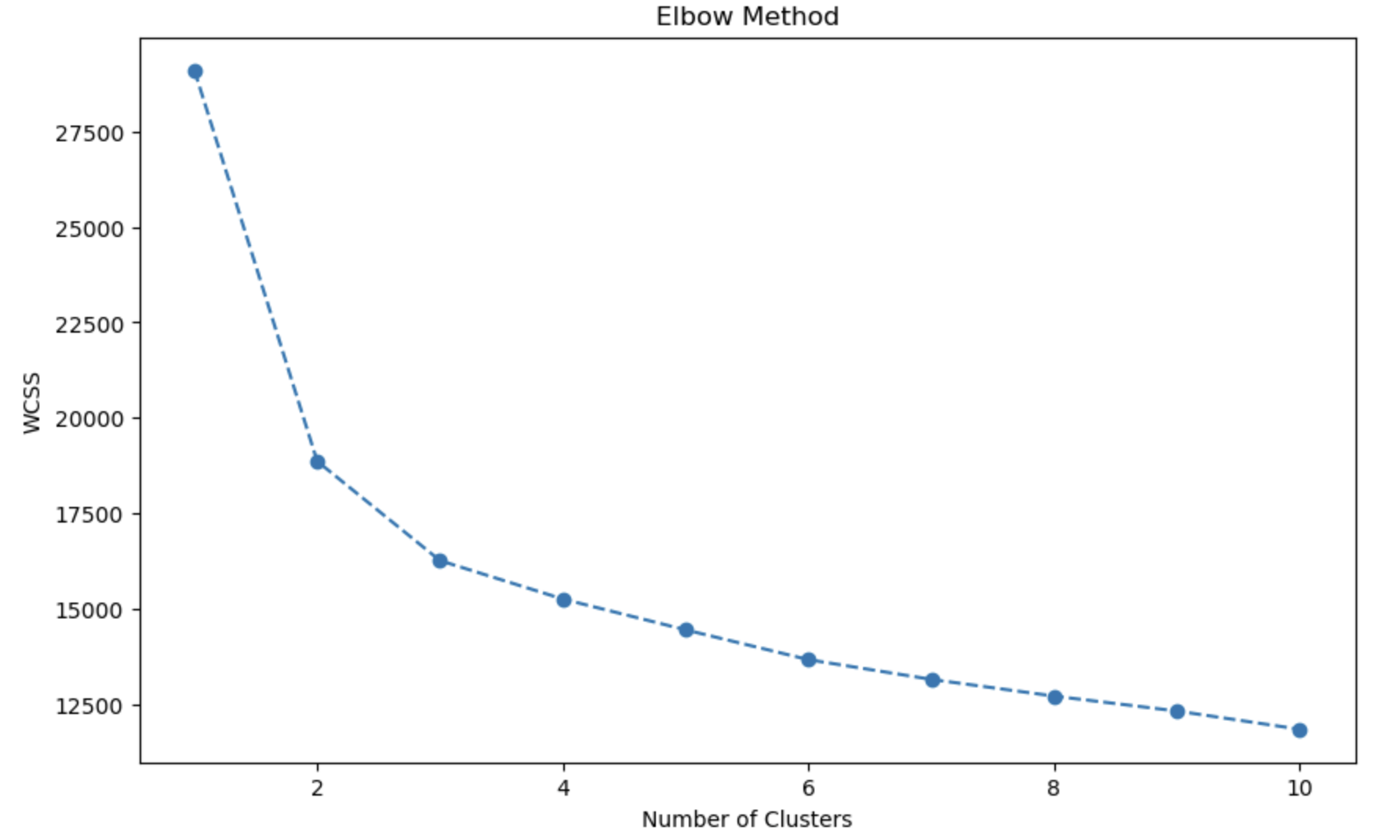
2. Testing the clusters through Within-Cluster Sum of Square by Elbow Method

Slide 9
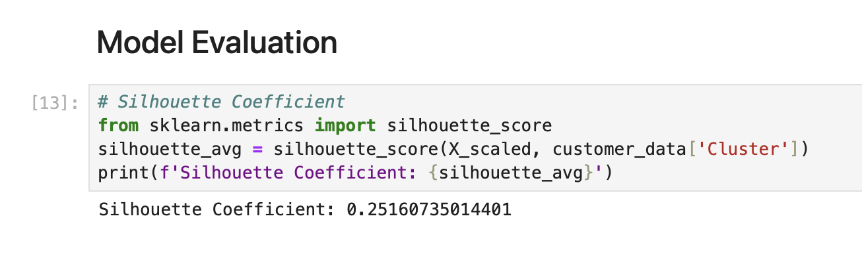
3. Evaluating Clusters with Silhouette Coefficient

Slide 10
Churn Prediction

Slide 11
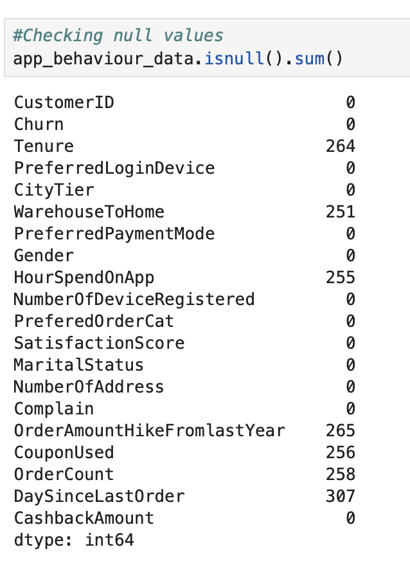
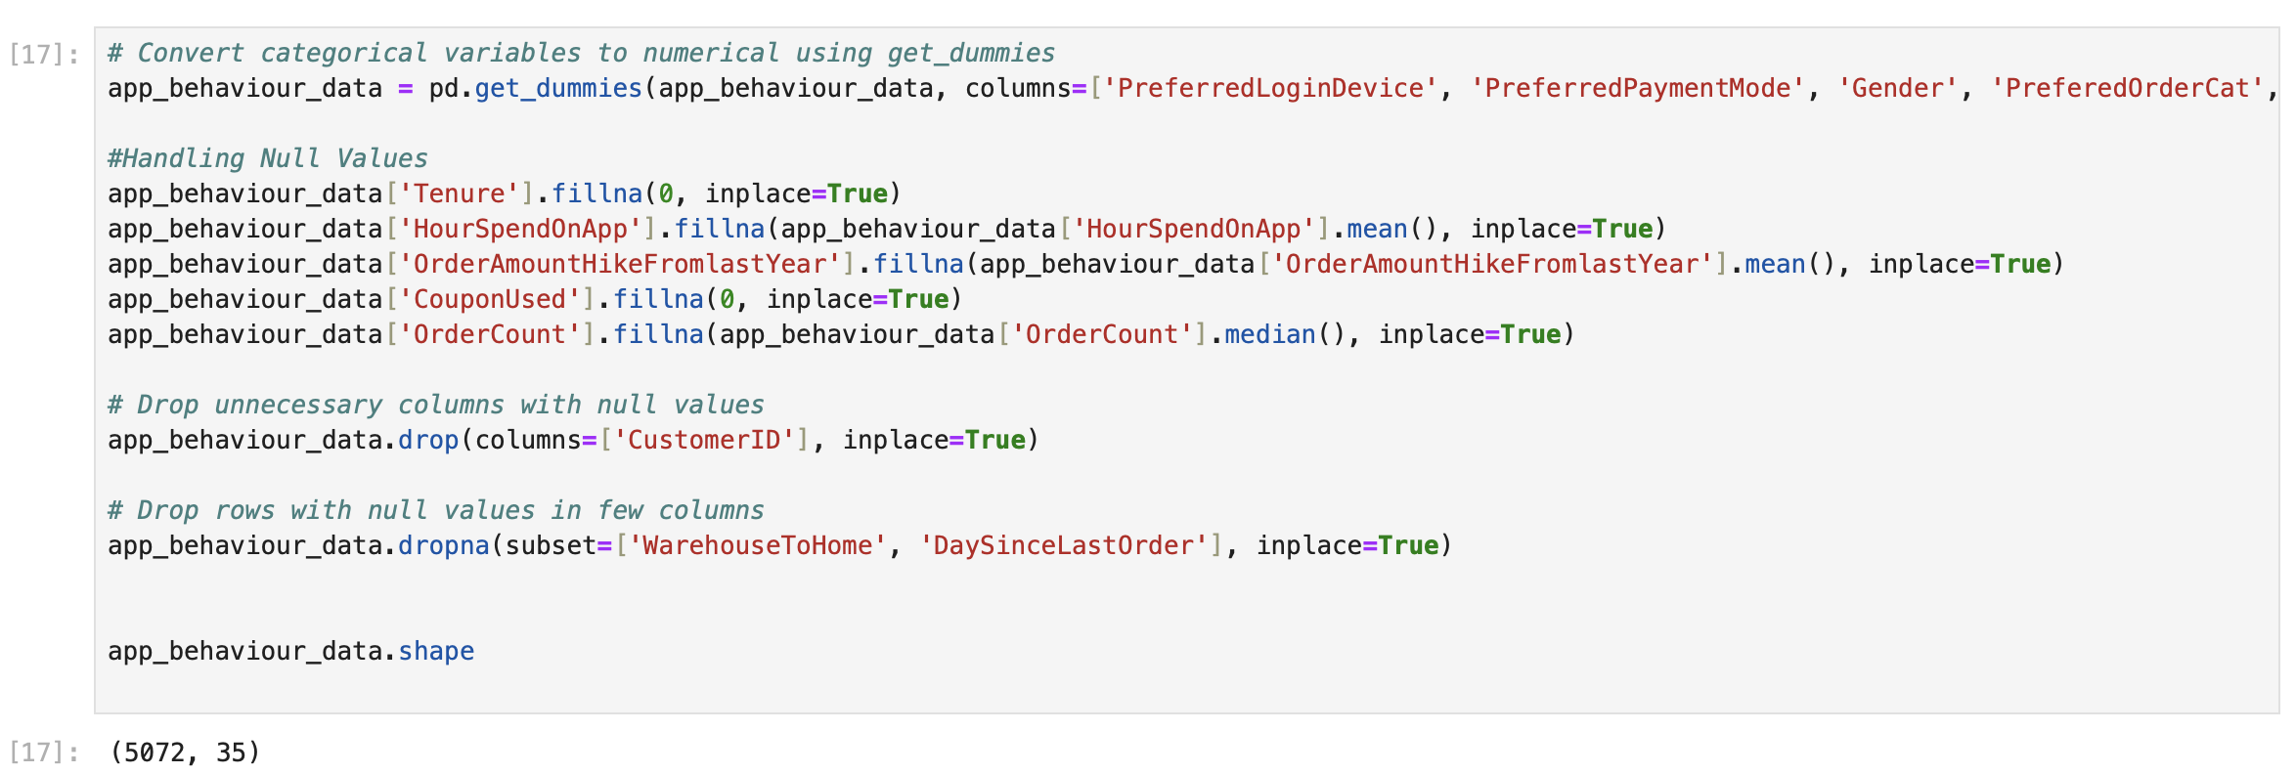
1. Handling Null Values
Replacing few null value columns’ values with appropriate substitutions.
Dropping 2 columns; WarehouseToHome & DaysSinceLastOrder, since they hold much relevance to model building.

Slide 12
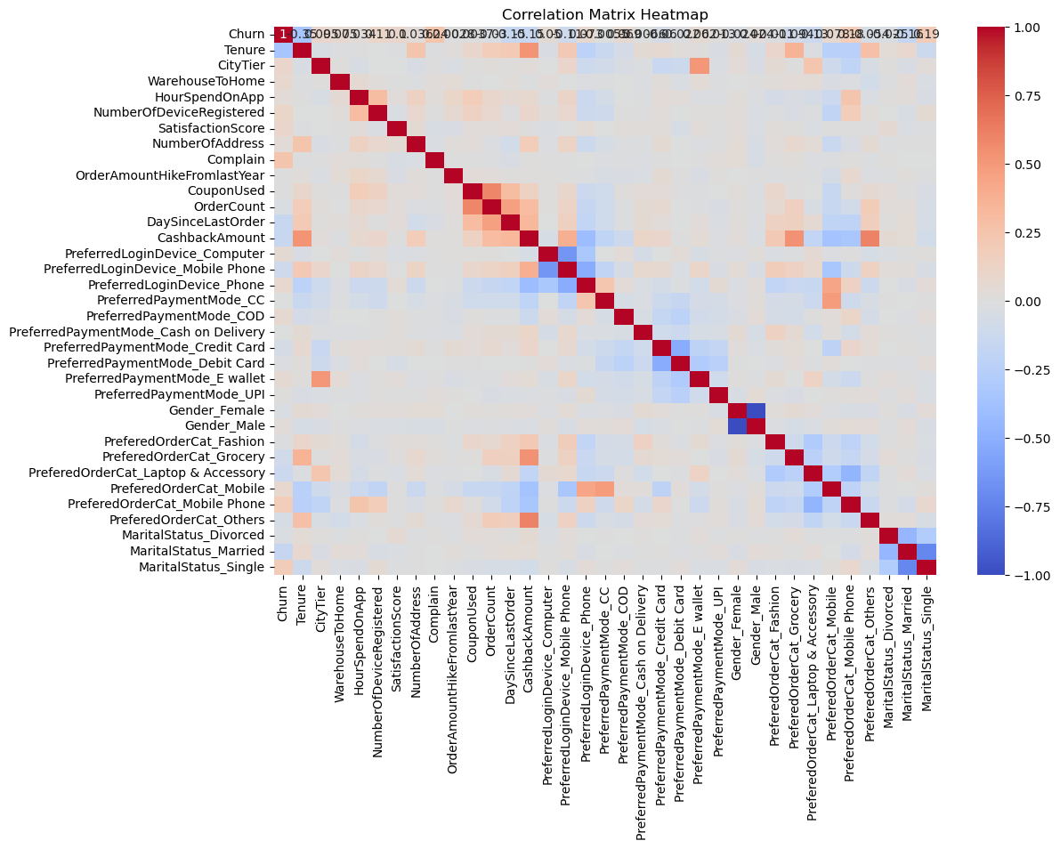
2. Correlation Matrix Heatmap

Slide 13
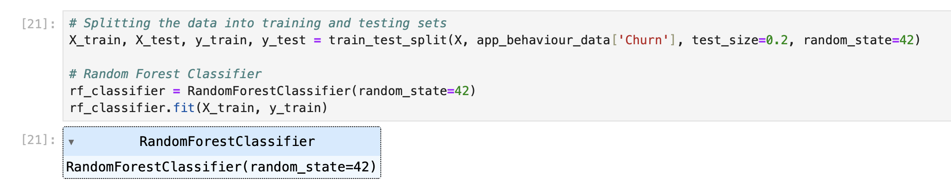
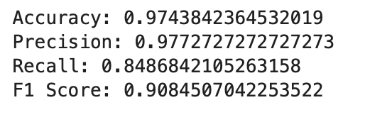
3. Model Building & Evaluation

